Slide 1
CSCIE-71-Project
BrainCradle Team
DEVON LUONGO – PRODUCT OWNER
DIGANT SHAH – SCRUM MASTER
SHIVAS JAYRAM – DEV TEAM MEMBER
AILINg WANG – DEV TEAM MEMBER

Slide 2
Far Vision & Near Vision
Far Vision: Democratize AI for the Common Good
Create a one-stop shop to help students, educators, researchers and businesses cut through the hype, and learn how AI technology can be successfully leveraged to solve real world problems, drive new business opportunities, accelerate innovation efforts and create a positive impact on humanity.
Near Vision: Aggregate content related to AI, Build an online community for knowledge sharing
Create an online channel for students, educators, researchers and technologists for learning and sharing knowledge in the field of Artificial Intelligence, Machine Learning & Neural Networks.

Slide 3
Stakeholders
Primary: Peter Henstock (Professor - Harvard Extension School) https://www.linkedin.com/in/peterhenstock/
Secondary: Andrew Kiriakedes (Professional Data Scientist - Accenture) https://www.linkedin.com/in/andrew-kiriakedes-565267123/
Additional: Hazem Salama (Student/SE)
Additional: Andy Roy (AI product startup)

Slide 4
Persona Example 1
Peter Henstock:
Bio: Expert in solving industry problems using machine learning & AI. Harvard Lecturer in Machine Learning & SW engineering.
Goals: Apply machine learning, data mining, visualization and analytics skills to solve key problems..
Frustration: Data science is a hybrid field integrating computer science, visualization, statistics, and business knowledge. The standard skill set emphasizes breadth over depth yet both are critical so looking to continuously enhance my knowledge in this field.
Motivation: Easy to Learn, Contains real world examples
Looking for: I'm looking for a site that will help me keep in touch with trends in this field and stay current on latest technologies.

Slide 5
Persona Example 2
Andrew Kiriakedes:
Bio: Business & Technology expert with focus on Data Science.
Goals: Leverage AI & advanced analytics to solve business problems.
Frustration: Limited options online to help me test hypothesis in AI, ML & Neural Networks.
Motivation: Ability to experiment with new ideas in this field.
Looking for: I'm looking for a site that serves as one stop channel to get trends and provides a playpen to test new ideas in this field and publish original thoughts.

Slide 6
Persona Example 3
Andy Roy:
Bio: A results-driven technology and marketing executive with proven expertise in marketing, sales management, technology consulting, program management and product design.
Goals: Working on AI product startup that focuses on chat-bots and predictive analytics help engage consumers along the path to purchase.
Frustration: Not easy to stay up to date on AI trends
Motivation: Easy to Access, Online Channel, Free
Looking for: I'm looking for a site that will simplify assimilating trends related to AI

Slide 7
Persona Example 3
Hazem Salema:
Bio: Software Engineer with interest in Artificial Intelligence and Machine Learning fields.
Goals: Application of Artificial Intelligence to achieve business goals and help in non-profit initiatives
Frustration: Scarcity of real-life example projects to learn from. Most examples are made up of nicely extracted data with lack of real-life aspects of data collection
Motivation: Passion for data exploration and the ability of Artificial Intelligence to help businesses and non-profit organizations
Looking for A site that provides real-life examples and projects done by expert Machine Learning and Artificial Intelligence practitioners

Slide 8
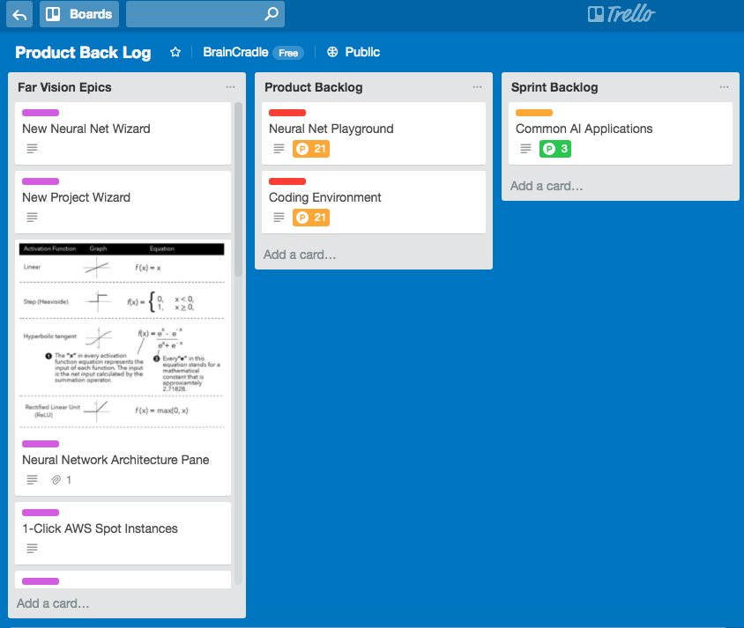
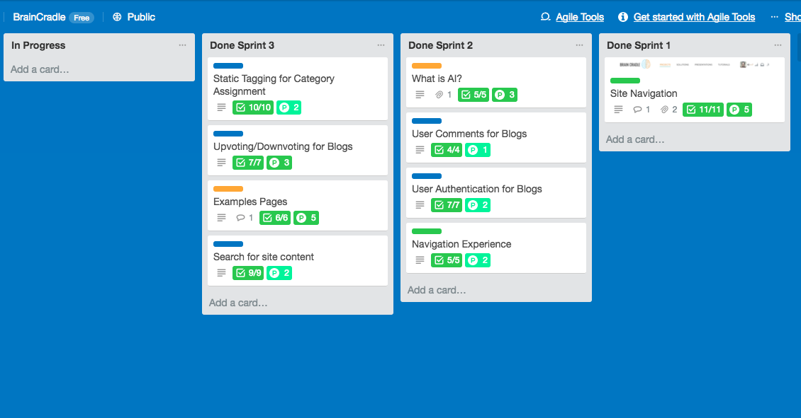
KANBAN BOARD

Slide 9
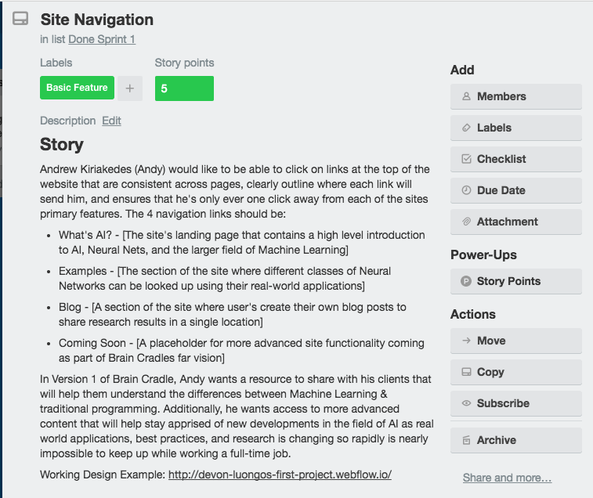
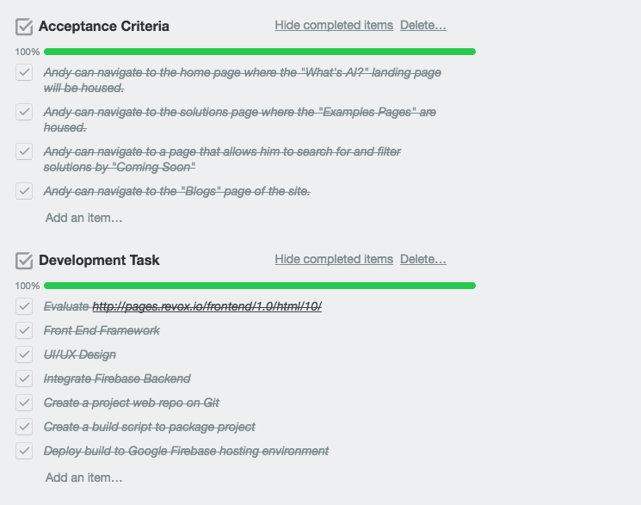
Finished PBI (Sprint1: Site Nav)

Slide 10
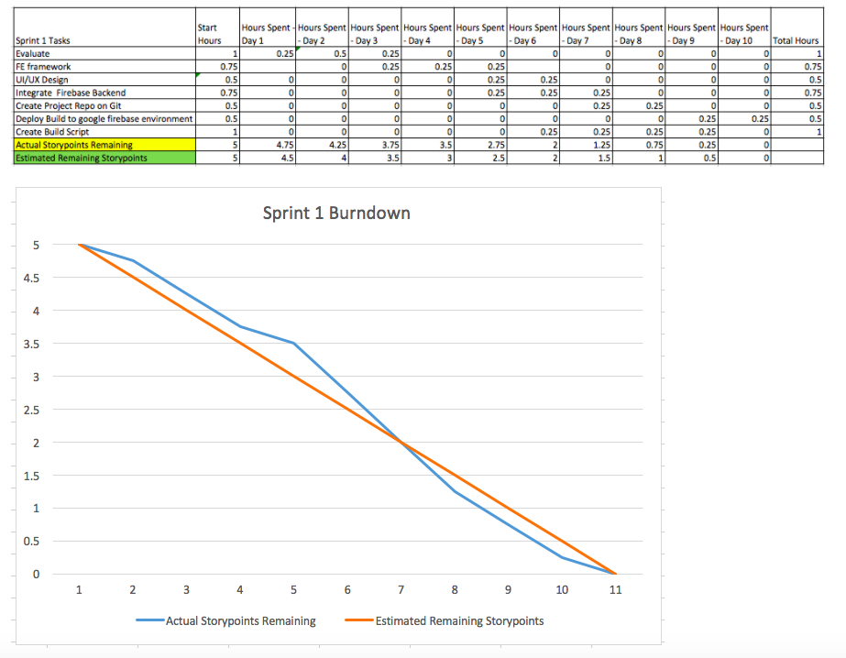
Sprint 1 Burndown

Slide 11
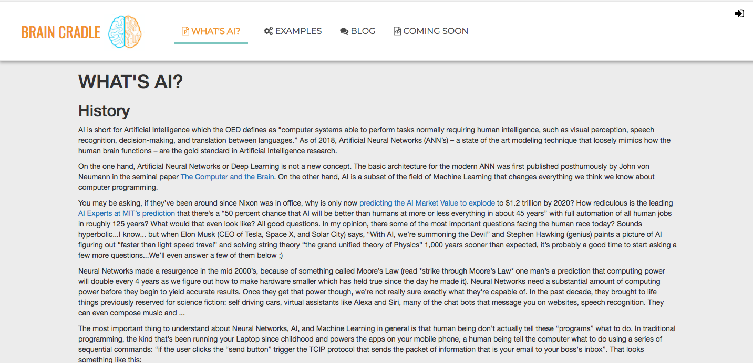
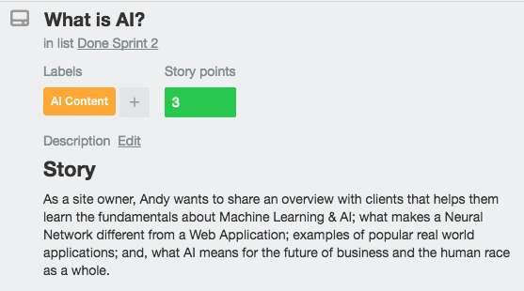
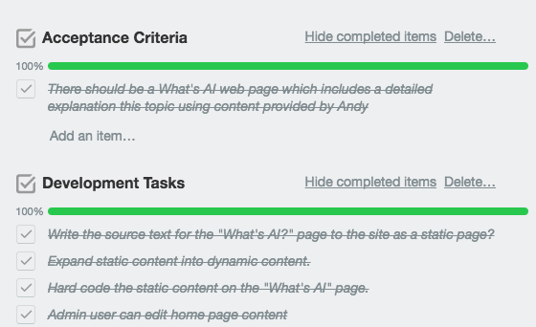
Finished PBI (Sprint2: What is AI)

Slide 12
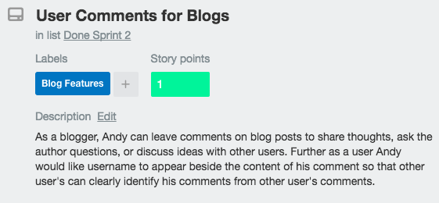
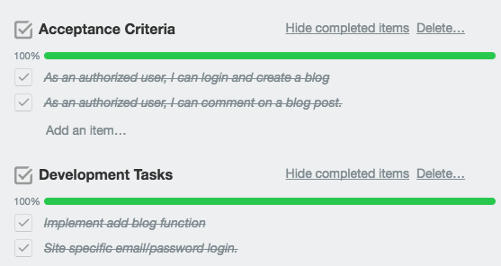
Finished PBI (Sprint2: User Comments)

Slide 13
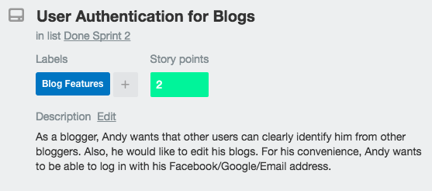
Finished PBI (Sprint2: User Auth)

Slide 14
Finished PBI (Sprint2: Nav Experience)

Slide 15
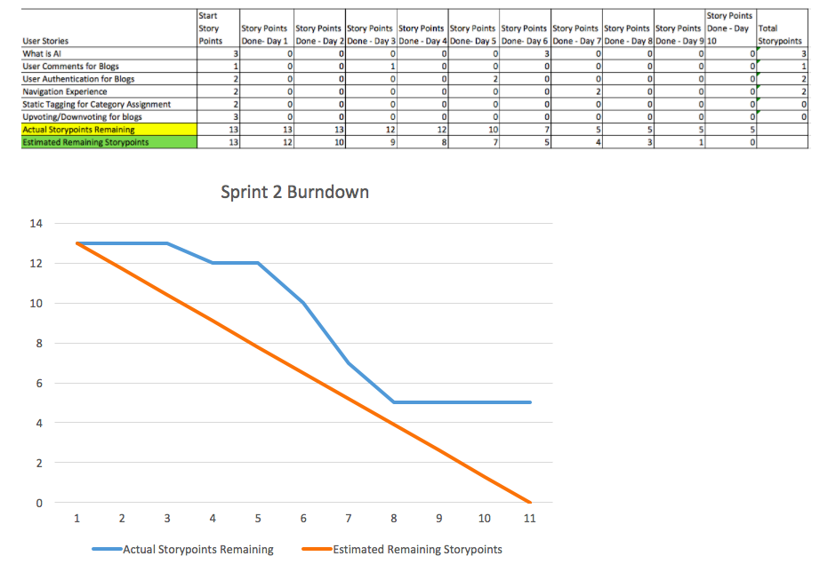
Sprint 2 Burndown

Slide 16
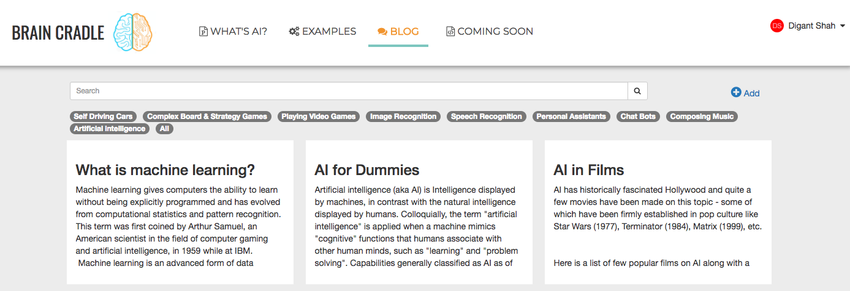
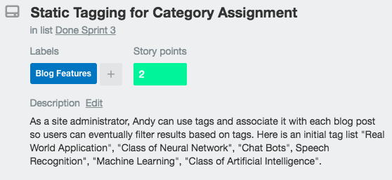
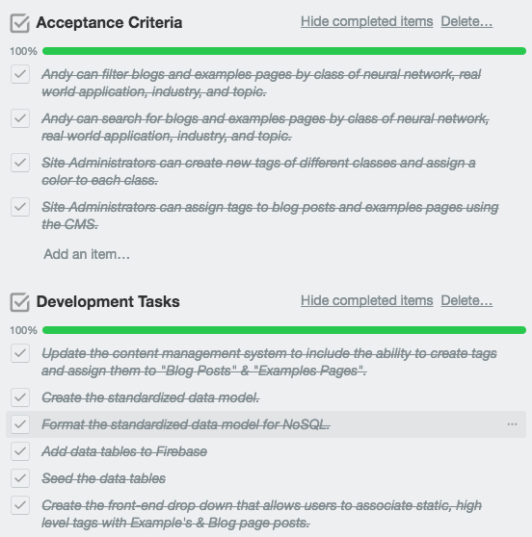
Finished PBI (Sprint3: Static Tagging)

Slide 17
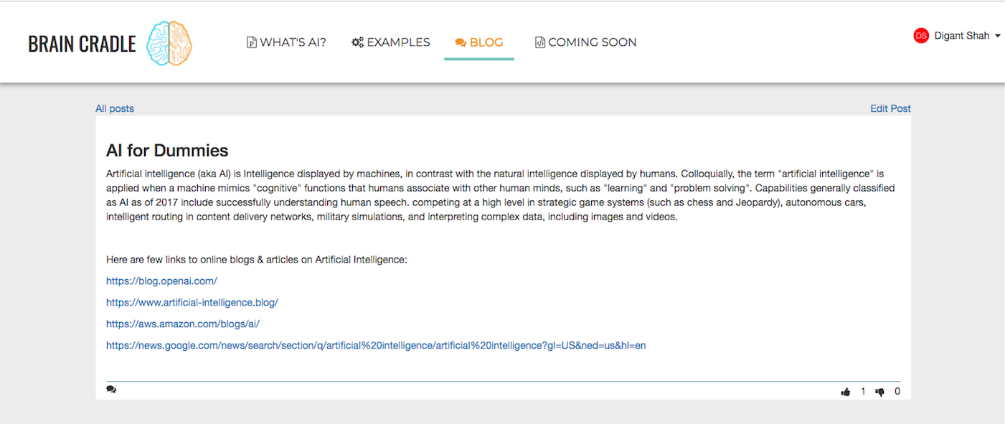
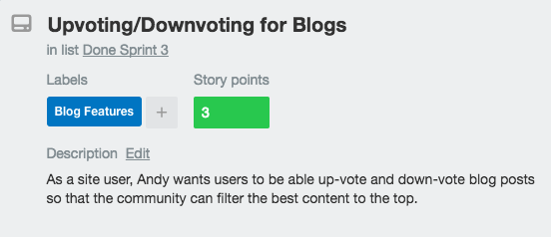
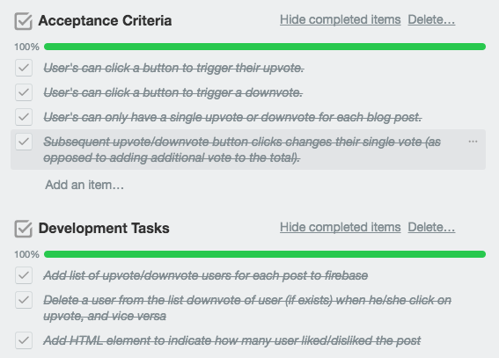
Finished PBI (Sprint3: Blogs Voting)

Slide 18
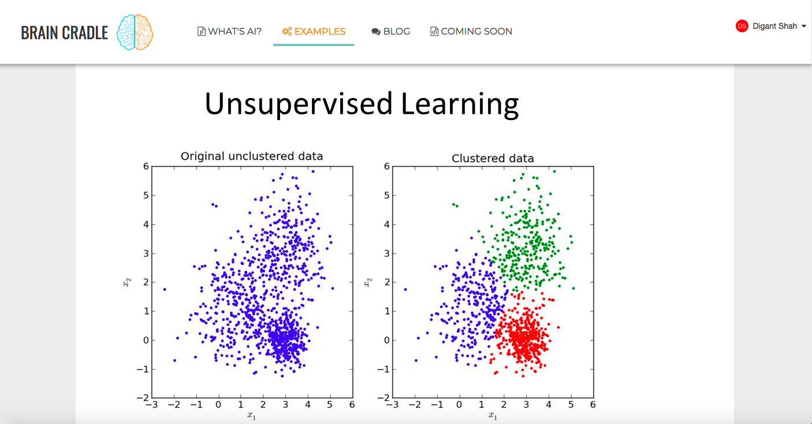
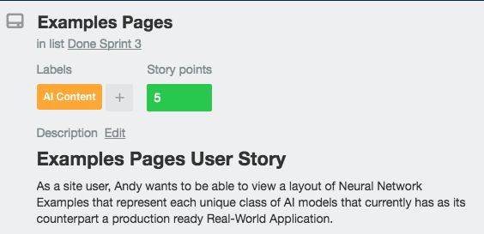
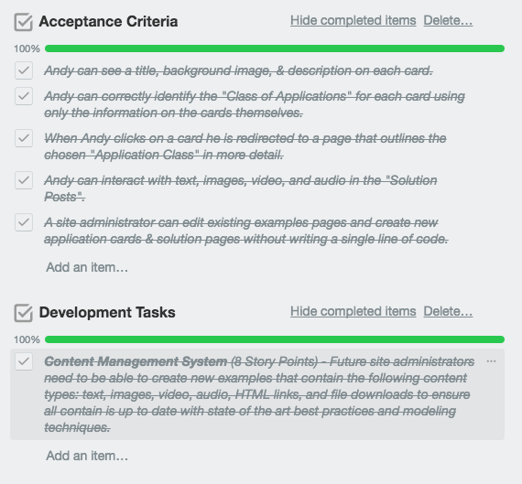
Finished PBI (Sprint3: Example Pages)

Slide 19
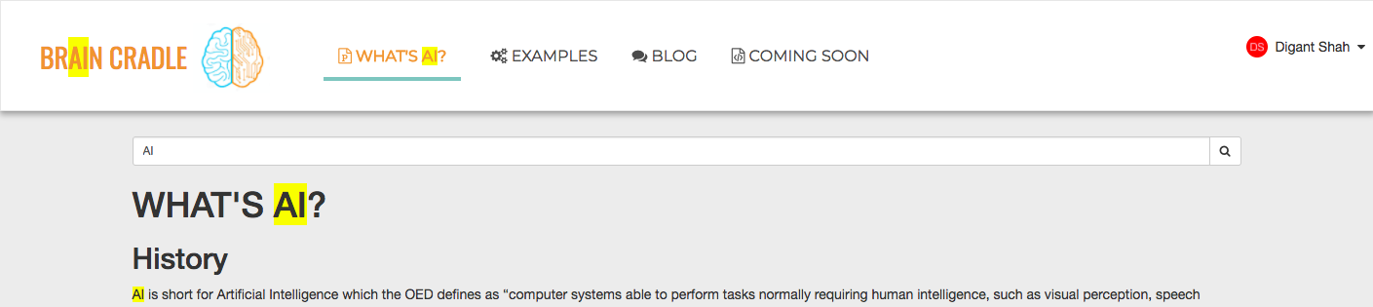
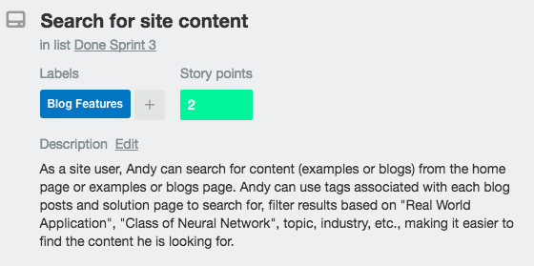
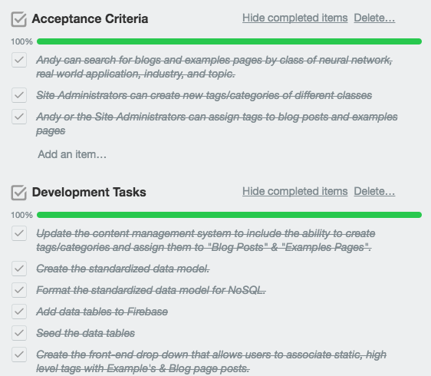
Finished PBI (Sprint3: Search site)

Slide 20
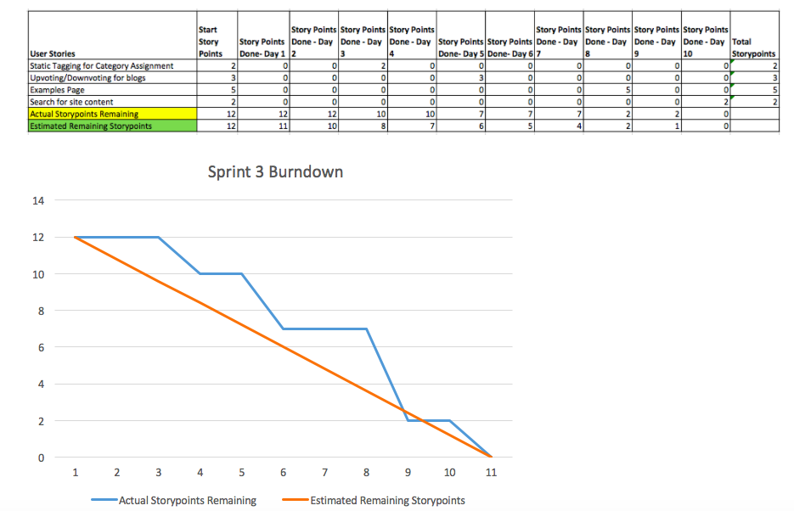
Sprint 3 Burndown

Slide 21
Dev Stack
Angular , Node JS & Firebase Coding Frameworks
Webstorm IDE
Karma for TDD Test Cases
Selenium & Cucumber for BDD Tests
Github for version control repository
Gulp & Travis for CI/CD

